Slide 1
Modelleren en Systeemontwerp
Object-oriented design

Slide 2
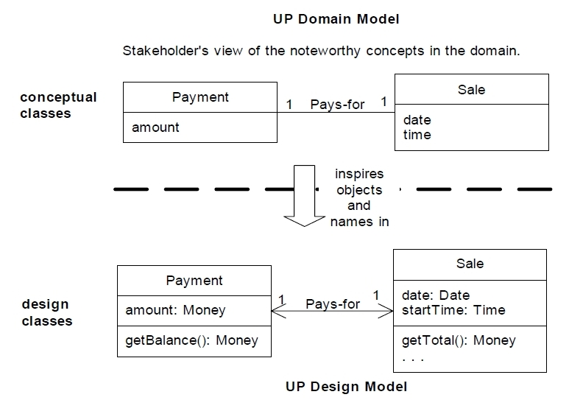
This lecture

Slide 3
This lecture
From analysis to design:
How can I use a domain model to write class diagrams?
Can I make quality requirements more explicit?
What principles guide this process?

Slide 4
Domain models vs classes
A domain model should not attempt to organize a system in classes
So how do you design a software system?
There is a lot of freedom when designing a new class:
What methods should this class dene?
Which methods should be public? Which methods should be private?
How much code should go into a method?
Should these methods all be defined by the same class?
What constitutes good design?
How can I decompose a big problem into manageable pieces?

Slide 5
Case study
Let us start by explaining functional design..

Slide 6
Case study
Suppose you need to access a list of shapes stored in a database and then display them
How would you go about planning to implement this?

Slide 7
Plan of attack
Locate the list of shapes in the database
Open up the list of shapes
Sort this list of shapes in some manner
Display every shape in the list individually

Slide 8
Functional decomposition
A functional decomposition breaks a problem into small subproblems (repeatedly)
This is fine for some problems. . .

Slide 9
Requirements always change

Slide 10
Requirements change
We need a new database schema
Can you extend the code to handle a new shape?
We need to generate different visualization methods
Can you sort the shapes in a different way?
…

Slide 11
A critique of functional design
A functional decomposition is what you would typically do to split code into methods
On a bigger scale, it might mean that a single change to the requirements may have consequences for a lot of different pieces of code
For example, if a new kind of shape is introduced, I may need to adapt all my code.

Slide 12
Changing requirements
Requirements change for all kinds of reasons:
You may have missed something when talking to a client;
You made a mistake in the requirements document;
You learn something during the initial implementation, uncovering technical problems or hidden assumption;
Client changes their mind;
Politics change;
The market changes.
. . .

Slide 13
The functional solution
You might say that the functional design solution sketched earlier is weakly cohesive and tightly coupled.
What do these words mean?

Slide 14
Cohesion
Cohesion refers to how closely the operations in a unit of code (typically a method or object) are related.

Slide 15
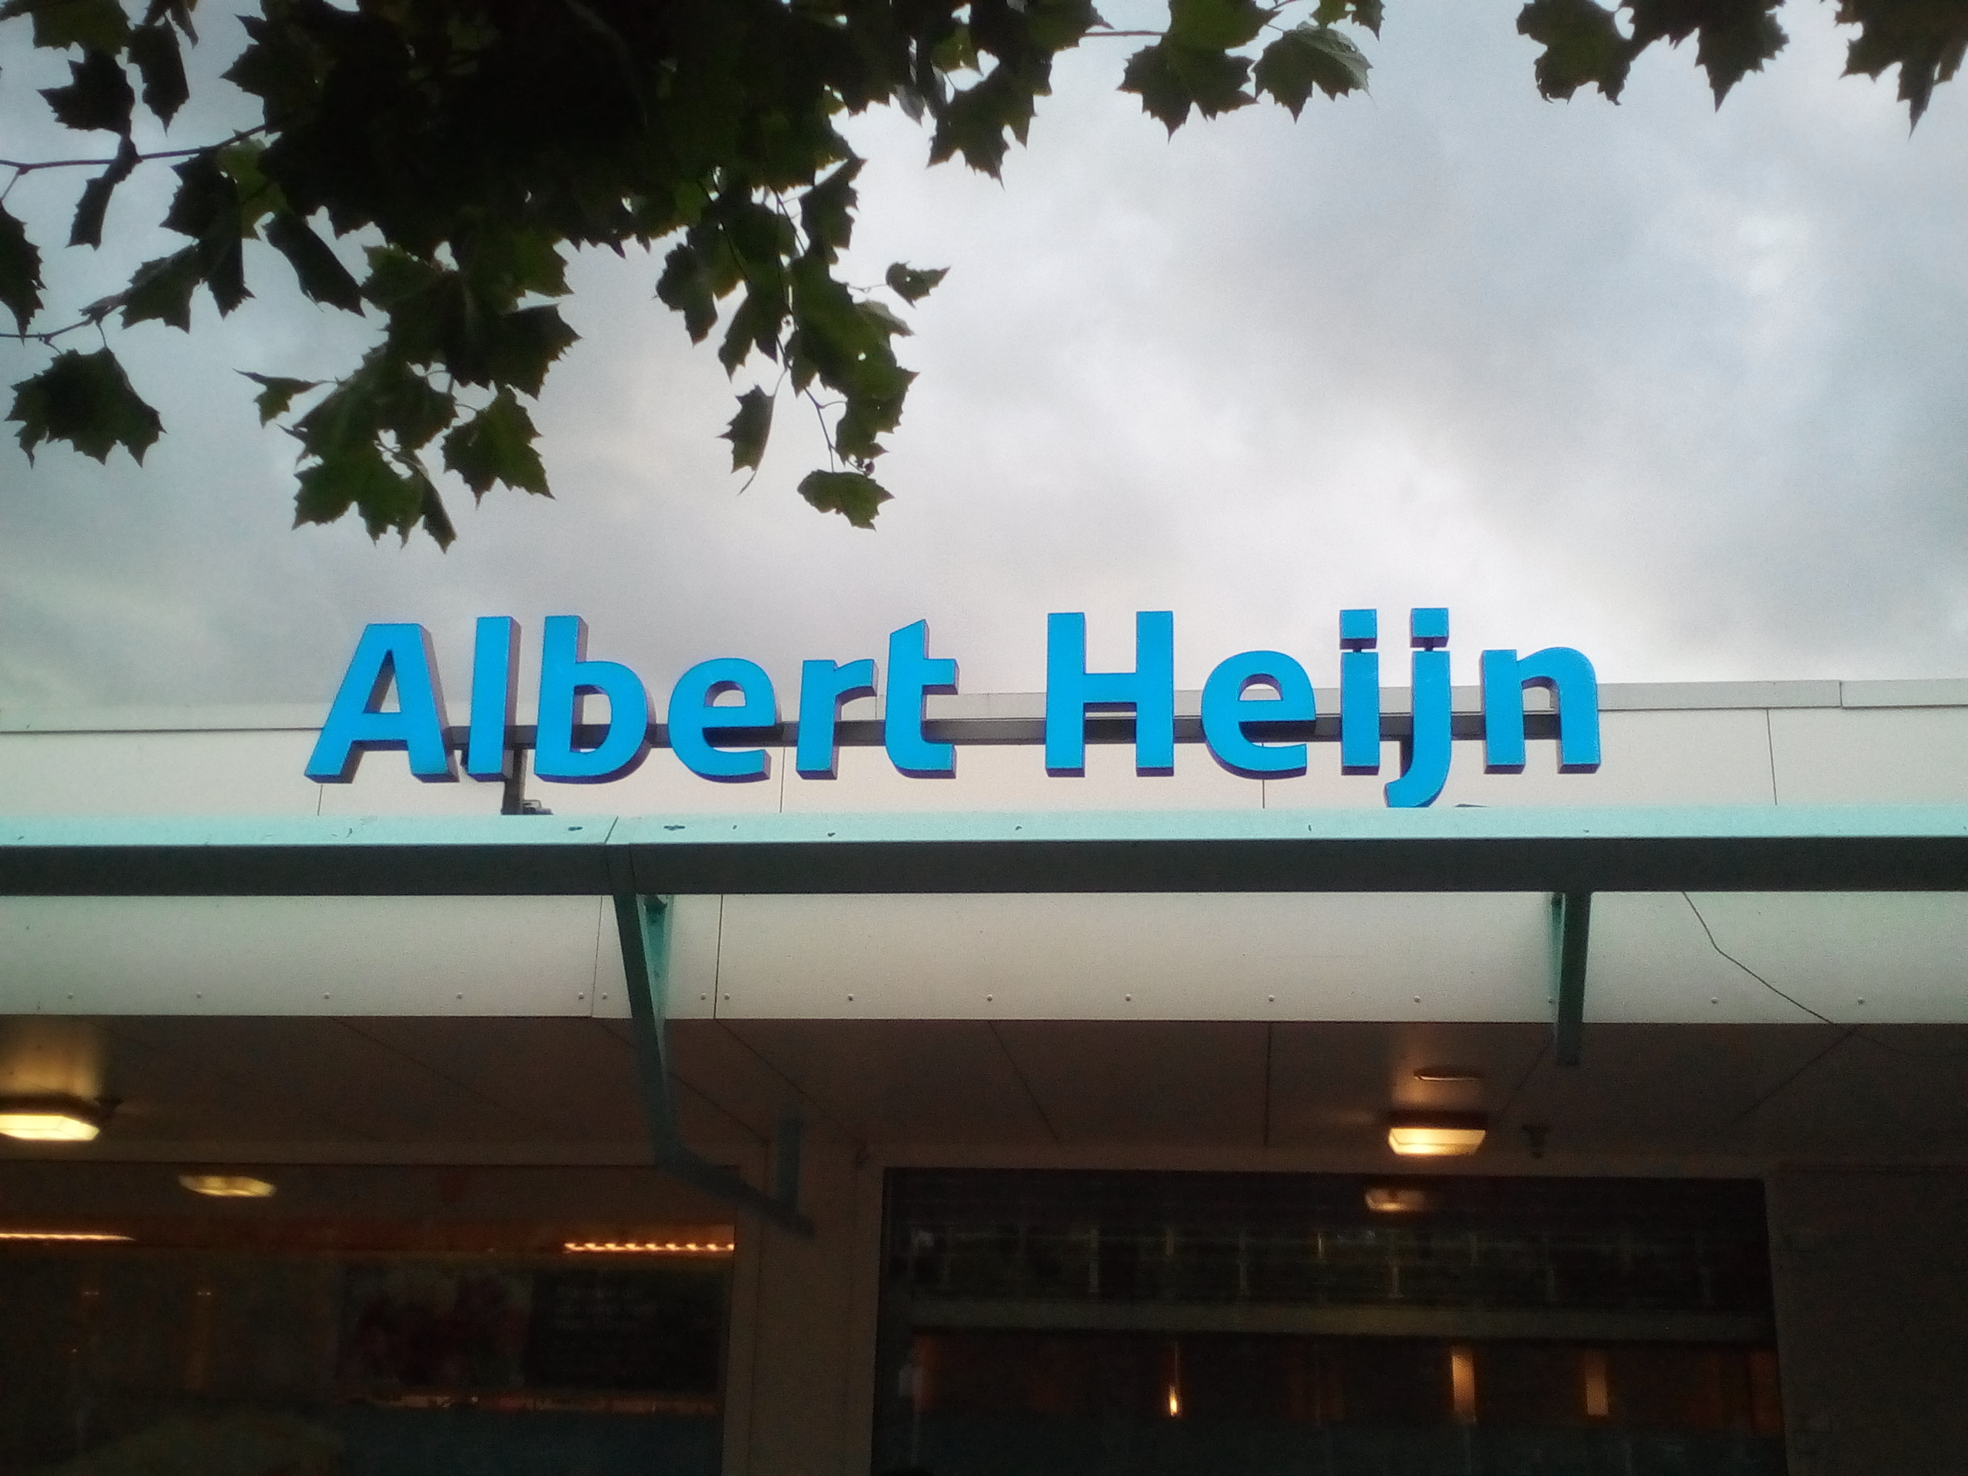
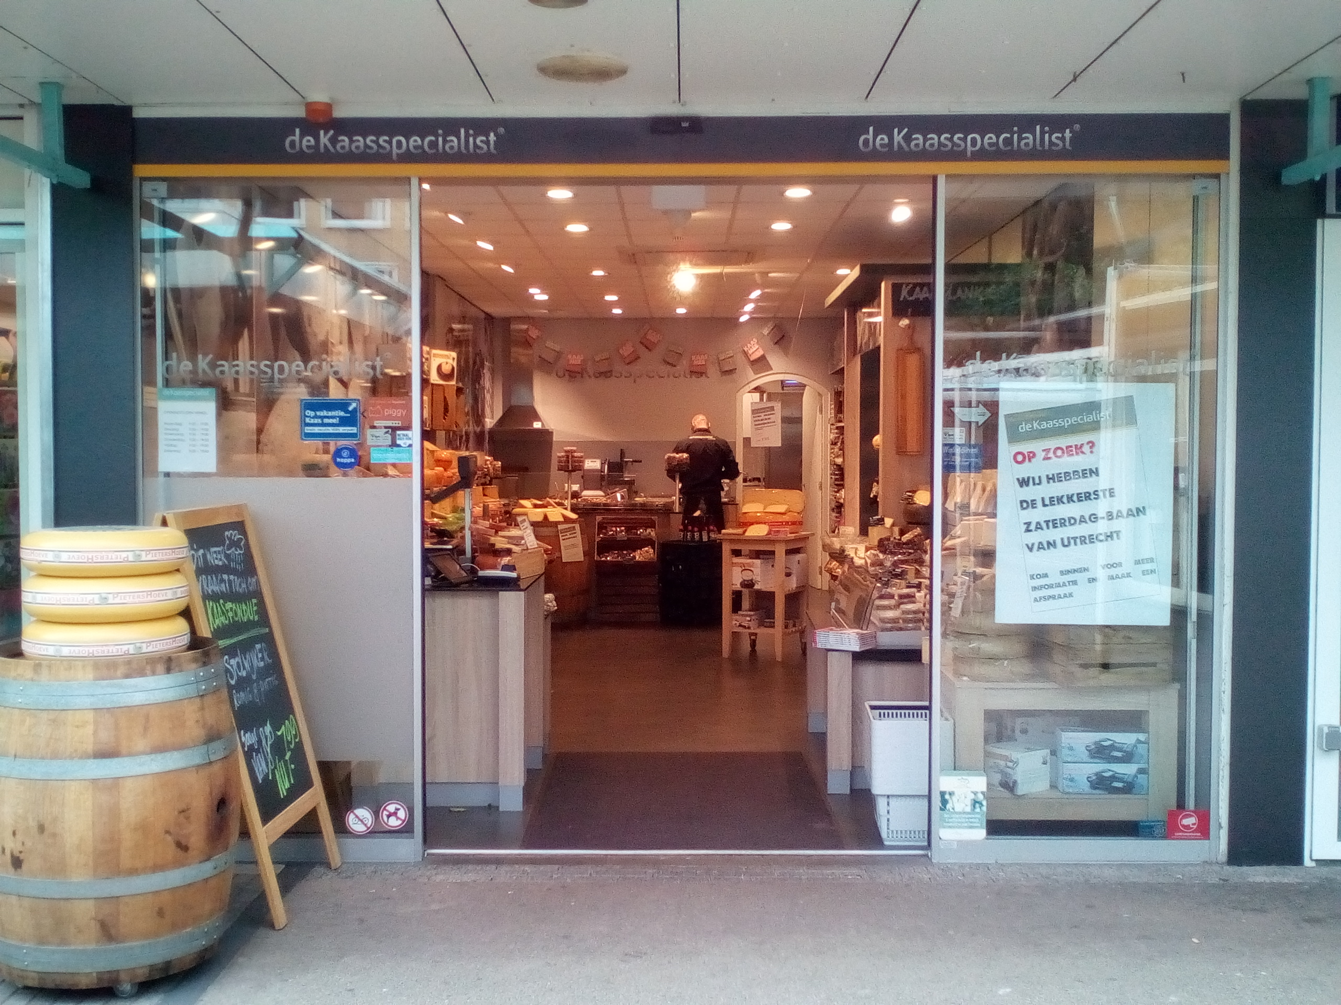
Cohesion (example)
Low cohesion - The convenience store. You go there for everything from gas to milk to ATM banking. Products and services have little in common, and the convenience of having them all in one place may not be enough to offset the resulting increase in cost and decrease in quality.
High cohesion - The cheese store. They sell cheese. Nothing else. Can't beat them when it comes to cheese though.

Slide 16
Strong or weak cohesion?
public void HandleStuff
(Data d, int quantity, int screenX, int screenY,
int status, Color c, ...) {
UpdateCorporateDatabase (d,q,status);
for (int i = 0; i < quantity; i++)
profit[i] = revenue[i] –
expense[i] * status;
newColor = c; status = SUCCESS;
DisplayProfits(screenX,screenY,status,d,c);
...

Slide 17
Cohesion
A function like sin(x) or tan(x) has very strong cohesion: it does exactly one thing.
You should try to have every method do one thing and one thing only.

Slide 18
Why is strong cohesion important?
Code is easier to maintain - if the implementation of sin changes, no other method needs to be updated.
Code is easier to understand - strong cohesion can help to break a large code base into easily digestible parts.
Code is easier to reuse - code that performs one clearly defined task is more generally applicable than one giant method.

Slide 19
Cohesion
People distinguish many different forms of cohesion.
Steve McConnell's Code Complete (Microsoft Press, 1993) has a good chapter discussing different forms of cohesion - wikipedia's entry is more terse.
If you cannot come up with a clear name for a method, it’s usually a sign of weak cohesion:
DoIt, HandleStuff, Step7, vs:
GetIconLocation, EraseFile, CalculateInterestRate
Exercise: Look at some old code you wrote, for example the Reversi game from IMP or Tetris from GAMEP. How cohesive are your methods?

Slide 20
Coupling
Cohesion refers to how closely the operations within a program module (method, object, or whatever) are related.
Coupling refers to how closely different program modules (or more specifically, objects or methods) are related.

Slide 21
Coupling (example)
Loose coupling: You and the guy at the convenience store. You communicate through a well-defined protocol to achieve your respective goals - you pay money, he lets you walk out with the bag of Cheetos. Either one of you can be replaced without disrupting the system.
Tight coupling: Me and my partner.

Slide 22
Types of coupling
Data coupling - one method relies on the data produced by another method.
Example: calling the tan method
Control coupling - one method or object tells the other what to do.
Example: setting control flags to print in color or not.
Global data coupling - methods sharing the same global variable.
Example: storing configuration data in a global variable.
Pathological coupling - one method relies on an exact implementation of another method.
Example: relying that sin(0) returns 0 within 0.001ms;
Example: relying that the third field of every table in the database is a key.

Slide 23
Why is loose coupling important?
If two modules are tightly coupled, changing one is more likely to need additional changes.
Example: changing the database schema needs a complete code overhaul.
If modules are tightly coupled, they are harder to assemble or tear apart.
Example: two modules sharing the same global variable.
If two modules are tightly coupled, they are harder to reuse or test.
Example: it takes a lot of set-up time to test a series of modules sharing global variables, compared to a function like sort.

Slide 24
Coupling: functional programming
Haskell enthusiasts always claim that Haskell programs are:
easy to test;
easy to reason about;
easy to reuse;
Pure functions are always (fairly) loosely coupled.

Slide 25
Coupling: subtle business
A floating point number is passed to the tan method.
A name, address, date of birth, and customer ID is passed to a method that uses all these parameters.
A Person object is passed to a method, that uses all this information.
A Person object is passed to a method that sends a birthday card, if it is the customer's birthday.
A X object with 27 fields is passed to a method, that uses 19 of them.
A method edits the customer information in a database. It calls another method, passing the customer ID. This second method consults the database to see the changed values.

Slide 26
Coupling
Exercise: Look at some old code you wrote, for example the Reversi game from IMP or Tetris from GAMEP. How are your methods and objects coupled?

Slide 27
Back to functional design
If a design is tightly coupled or weakly cohesive, this is regarded to be a Very Bad Thing: a minor change can affect a lot of other parts of the system!
Functional design (repeatedly) decomposes a problem into smaller subproblems - and solves these subproblems in separate methods.
But if the input data changes, all these functions could be affected!

Slide 28
Responsibility
A key concept in object oriented analysis and design is that of responsibility.
Let's go back to our use case. . .

Slide 29
Back to our use case
Customer arrives at checkout with goods to purchase
Cashier starts a new sale
Cashier records item description, price, and running total for each item
System computes sales total, including tax
Cashier informs Customer of the total and processes payment
System logs completed sale, sends payment info to Accounting and Inventory departments
System prints a receipt
Happy Customer leaves with receipt and goods

Slide 30
Object-oriented design
Responsibilities are assigned to classes during design:
Does the system compute the Sales total? Or is it part of the Sale?
Who is responsible for pricing information?
How does information flow to the Accounting and Inventory departments?

Slide 31
Taking a step back
Martin Fowler identifies three separate perspectives on the software development process:
Conceptual
Specification
Implementation

Slide 32
Conceptual perspective
This perspective “represents the concepts in the domain under study. . . a conceptual model should be drawn with little or no regard for the software that might implement it”

Slide 33
Specification perspective
“Now we are looking at software, but we are looking at the interfaces of the software, not the implementation”

Slide 34
Implementation perspective
“This is probably the most often-used perspective, but in many ways the specification perspective is often a better one to take”

Slide 35
Object-oriented design
Shalloway and Trott argue that these three levels are useful to understand objects:
Conceptual - an object is a set of responsibilities
Specification - an object is a set of methods
Implementation - an object is code and data
The object-oriented design thinks in terms of objects and responsibilities first

Slide 36
Example: shape database
Our functional design yielded the following steps:
Locate the list of shapes in the database
Open up the list of shapes
Sort this list of shapes in some manner
Display every shape in the list individually

Slide 37
Example: object-oriented design
ShapeDB class
getCollection method returns the set of shapes
Abstract Shape class
display method
Subclasses of Shape such as Square or Circle
Collection class
display_collection method, displays all Shapes in the Collection
sort method, sorts the shapes in some order

Slide 38
Example execution
Main program creates a ShapeDB object
Main program asks the ShapeDB object for the collection of Shapes
Main program asks the Collection to sort the Shapes
Main program asks the Collection to display the Shapes
The Collection asks each Shape to draw itself

Slide 39
Robust to change?
What happens if we add a new Shape?
What happens if we want to sort differently?

Slide 40
Robust to change?
What happens if we add a new Shape?
We can define a new subclass of the Shape, with its own display method
What happens if we want to sort differently?
We change the sorting method in the Collection class.
Both these changes are local to the objects responsible

Slide 41
Encapsulation
Why did this approach work?
Encapsulation is any form of information hiding:
The private methods of an object are hidden to the outside world
An abstract class ensures the implementation of its methods are ‘hidden’
Encapsulation enables classes to keep responsibilities exclusive: stay away from my responsibilities

Slide 42
Writing designs
So we have a better understanding of object oriented design. . .
. . . and we understand how to write use cases and requirements. . .
. . . and we know what a domain model is. . .
. . . and we are familiar with concepts like cohesion and coupling. . .
… but how do we write a design?

Slide 43
Writing designs
Coming up with a good design is hard - it requires creativity, technical insight, and an excellent understanding of the problem domain
During analysis, you gather information about the problem
During design, you come up with a solution
There is no single right or wrong answer
There is no one weird trick I can teach you that will always yield a good design

Slide 44
Responsibility
One key question to ask during design is: Which class is responsible?
Which class is responsible for computing the sales total?
Which class is responsible for logging sales? Or notifying the Accounting department?
Which class is responsible for drawing a shape? Or sorting the shape collection?

Slide 45
Responsibility
Responsibility is an abstract concept
Being responsible for database storage involves a lot of classes and methods
Being responsible for the VAT calculation is usually much simpler
A responsibility is not the same thing as a method, but methods are implemented to fulfill responsibilities

Slide 46
GRASP principles
Larman identifies several principles that help guide good design: the GRASP principles (General Responsibility Assignment Software Principles)
The GRASP principles help assign responsibility to the classes in your domain model

Slide 47
Grasp principles
The GRASP principles help assign responsibility to the classes in your domain model:
Information Expert (who has the info?)
Creator (who should create instances?)
Loose coupling (general quality guideline)
Strong cohesion (general quality guideline)
Controller (use case: which subsystem handles the event?)

Slide 48
Information expert (Example)
Example: Who calculates the sales tax?

Slide 49
Information expert (example
Every ProductSpecification should manage its own price
Every SalesLineItem records the price of selling these items
Every Sale should compute its own total price and tax
We can start to design the UML class diagrams recording the operations that these classes should support

Slide 50
Information expert (Grasp principle)
What information is necessary to perform some computation?
Which class or classes have this information already?
Assign responsibility to those classes that have the required information readily available

Slide 51
Creator (example)
Example: Who adds SalesLineItems to the current sale?

Slide 52
Creator (example)
A SalesLineItem is a part of a Sale
A Sale should be responsible for adding new SalesLineItems
And hence, the Sale class should support a makeLineItem method

Slide 53
Creator (GRASP principle)
Idea: Assign class B the responsibility to create instances of a class A if one or more of the following is true:
B aggregates A objects
B contains A objects
B records instances of A objects
B closely uses A objects
B has the initialization data necessary to create A objects
(Note the similarity in the last case with the Information Expert pattern)

Slide 54
Loose coupling (example)
A Register should support a makePayment() method that associates a new Payment with the current Sale

Slide 55
Loose coupling (example)

Slide 56
Loose coupling (example)

Slide 57
Loose coupling (example)
Apply loose coupling and choose!

Slide 58
Loose coupling (example)
In the right diagram, the coupling is looser: the Register does not need to know about Payments
So the Sale should be responsible for creating the associated Payment
Try to assign responsibilities in such a way that coupling remains loose
This is a rule of thumb - that can be broken when necessary

Slide 59
Loose coupling (GRASP principle)
Idea: Favor the design with loose(st) coupling
Tight coupling may introduce problems:
Propagation of code updates in related classes
Harder to understand in isolation
Harder to reuse
This principle is often combined with others, such as the Creator or Information Expert principles

Slide 60
Strong cohesion
Idea: Favor the design with strong(er) cohesion
Weak cohesion may lead to code that is:
hard to comprehend
hard to reuse
hard to maintain
hard to test

Slide 61
Strong cohesion (example)
What if the Register class needs to do lots of other things besides creating payments?
Remember that the prime responsibilities of Register are the interaction with the customer
So do not bother it with details concerning payments

Slide 62
Strong cohesion (example)
In this design, the Register does not know anything about payments
Great!

Slide 63
Strong cohesion
Like the Loose coupling principle, assigning responsibilities to strengthen cohesion is a rule of thumb…
…but break it with caution

Slide 64
Controller
Idea: Assign the responsibility for receiving or handling system events to a class
that represents the overall system, device, or subsystem
that represents a specific use case within which the system event occurs. Such a class is often called the Handler or Controller.
Motivation: Many use cases or scenarios mention that “The system does X” - but what class should represent “the system”? The Controller principle suggests designing separate classes to handle individual use cases.

Slide 65
Applying GRASP principles
You can use the data you have gathered (domain model, use cases, requirements documents, interaction diagrams, etc.) to design the software system.
One way to do this is through use case realizations – which involves defining the classes in the software system and how they collaborate to execute a particular use case.
Here the GRASP principles can justify your design choices.

Slide 66
Case study: NextGen POS system
Consider the following use case (fragment):
Customer arrives
Cashier tells the system to create a new Sale
Cashier enters item identifier and quantity
System records item identifier and quantity
Cashier repeats steps 3 and 4 until all items have been processed
System presents total with all taxes calculated
Question: Who is responsible for creating the new Sale object? What other data should be initialized once the Sale is created?

Slide 67
Case study: make new sale
Once the Customer arrives, the Cashier should initiate a new Sale in the system.
Applying the Controller principle, we should define a Register class that handles such requests (or if we have lots of different functionality, a specific SaleHandler class).
This Register class should provide a makeNewSale() method.
From our domain model, we have learned that a Sale also has a list of SalesLineItems. This list should also be initialized.
The Creator pattern suggests that this should be the responsibility of the Sale.

Slide 68
Case study: NextGen POS system
Consider the following use case (fragment):
Customer arrives
Cashier tells the system to create a new Sale
Cashier enters item identifier and quantity
System records item identifier and quantity
Cashier repeats steps 3 and 4 until all items have been processed
System presents total with all taxes calculated
Question: Who is responsible for computing the total price (including taxes)?

Slide 69
Case study: compute total
Calculating the price requires knowledge about all the items and quantities involved.
This is information that the Sale has.
We can now apply the Information Expert principle.
So: the Sale class should support a getTotal() method.

Slide 70
Case study: tax calculator
Or alternatively, perhaps you are worried about different sales tax calculations (in different countries, for instance).
Perhaps it would be better to have a specific TaxCalculator() Controller responsible for the calculation of sales tax.
Design is not about right and wrong - but balancing the different advantages and disadvantages.

Slide 71
Use case realizations
These examples show how to use the information in a use case during the design process.
Read Chapter 17 of Larman's Applying UML and Patterns for a thorough analysis.

Slide 72
Design validation
You can use the same techniques to check whether a design can implement a use case correctly. Does every class have the required information to perform some computation?
For example, when computing the total sale price, how does the Sale object know the price of the individual items? Or the quantities?

Slide 73
Different forms of information
There are four different ways in which a class A may have access to certain information in a class B:
Attribute visibility - B is an attribute of A
Parameter visibility - B is a parameter of a method of A
Local visibility - B is a local object in a method of A
Global visibility - B is globally visible to A (this is the least common form)

Slide 74
Design validation
When checking a design, run through use cases, and ask yourself the question:
How is the necessary information visible?

Slide 75
What we have seen today
We should think of objects abstractly as managing responsibilities
We can use the GRASP principles to assign responsibilities to the conceptual classes in our domain model
Doing so is a step towards turning our domain model into a concrete design

Slide 76
Material covered
Design Patterns explained: chapter 1
Applying UML and patterns: chapter 16-19

